Slide 1

8th Grade Math: Pre-Algebra
Unit 5, Lesson 9 Finding Distances on a Coordinate Plane Volume 1, pg. 221

Slide 2


Benchmark
MA.8.GR.1.2
Apply the Pythagorean Theorem to solve mathematical and real-world problems involving the distance between two points in a coordinate plane.
volume 1, pg. 221

Slide 3
Integrated Mathematical Thinking and Reasoning Standards
MA.K12.MTR.1.1 Actively participate in effortful learning both individually and collectively.
MA.K12.MTR.3.1 Complete tasks with mathematical fluency.
MA.K12.MTR.4.1 Engage in discussions that reflect on the mathematical thinking of self and others.
MA.K12.MTR.5.1 Use patterns and structure to help understand and connect mathematical concepts.
volume 1, pg. 221

Slide 4

Learning Target
I can determine the distance between two points on the coordinate plane.
volume 1, pg. 221

Slide 5

Warm-Up
volume 1, pg. 222

Slide 6
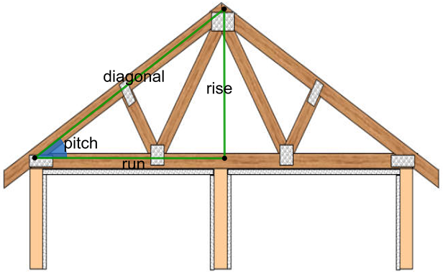
5.9.1 Warm-Up: Notice and Wonder
In carpentry, right triangles are commonly used in constructing roofs. A roof’s pitch is the steepness of the roof. It can be determined by the ratio between the two legs of the right triangle.
What do you notice or wonder about the use of right triangles in construction?
volume 1, pg. 222

Slide 7

Exploration
volume 1, pg. 222

Slide 8

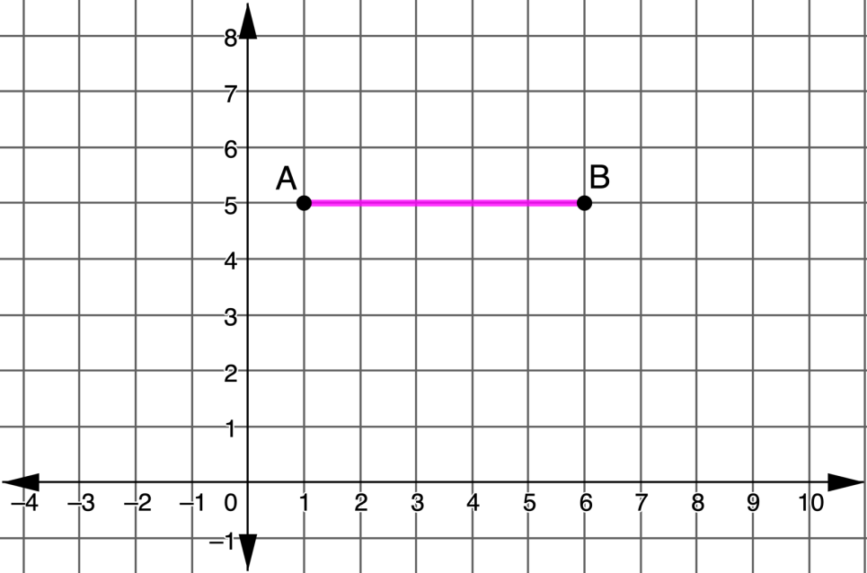

5.9.2 Exploration: Finding the Right Distance
Work with your partner to answer each of the following.
What is the distance between points $A$ and $B$?
volume 1, pg. 222

Slide 9
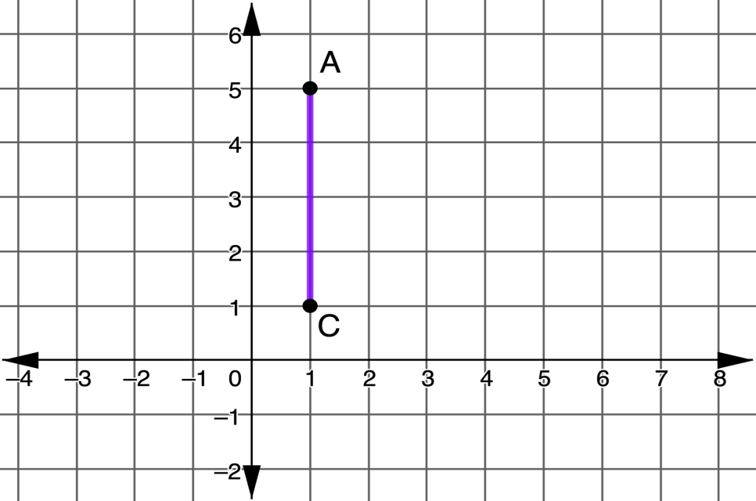

What is the distance between points $A$ and $C$?
What strategy did you and your partner use to find the distance of the horizontal and vertical lines?
volume 1, pg. 223

Slide 10
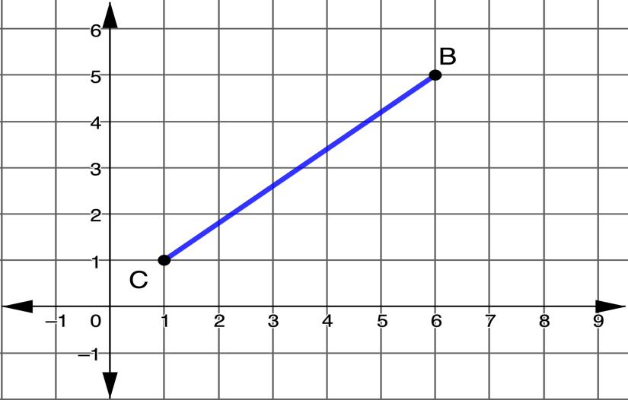

What is the distance between points $B$ and $C$?
On the graph, label the length of segment $BC, c.$
Create a right triangle with hypotenuse $c$ by sketching horizontal and vertical legs. Label the legs $a$ and $b$.
Apply the Pythagorean Theorem to find the length of $c$. Round to the nearest tenth if necessary.
volume 1, pg. 223

Slide 11
Discuss with your partner how to find the length of any diagonal on the coordinate plane.
Complete the statement. The length of any non-vertical or non-horizontal segment can be determined by using the endpoints as a of a right triangle and sketching the horizontal and vertical then applying the
hypotenuse
leg
hypotenuse
leg
Pythagorean Theorem.
Area Formula.
volume 1, pg. 224

Slide 12

Guided Practice
volume 1, pg. 224

Slide 13

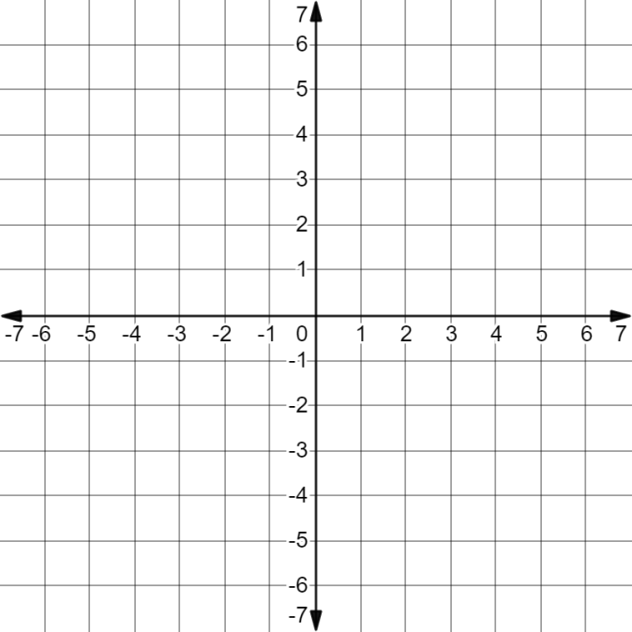
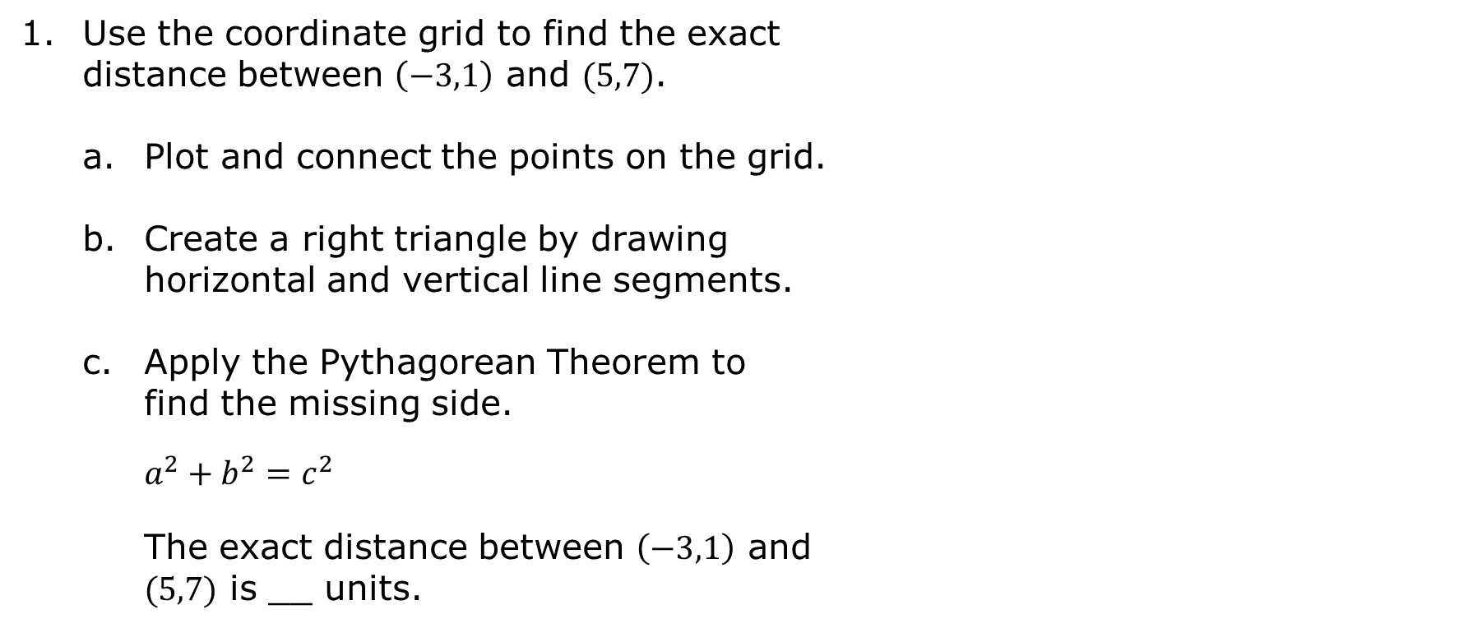
5.9.3 Guided Practice: Finding Distance on the Coordinate Plane
Use the coordinate grid to find the exact distance between $\left(−3,1\right)$ and $(5,7)$.
Plot and connect the points on the grid.
Create a right triangle by drawing horizontal and vertical line segments.
Apply the Pythagorean Theorem to find the missing side.
$$a^{2}+b^{2}=c^{2}$$
The exact distance between $\left(−3,1\right)$ and $(5,7)$ is __ units.
volume 1, pg. 224

Slide 14
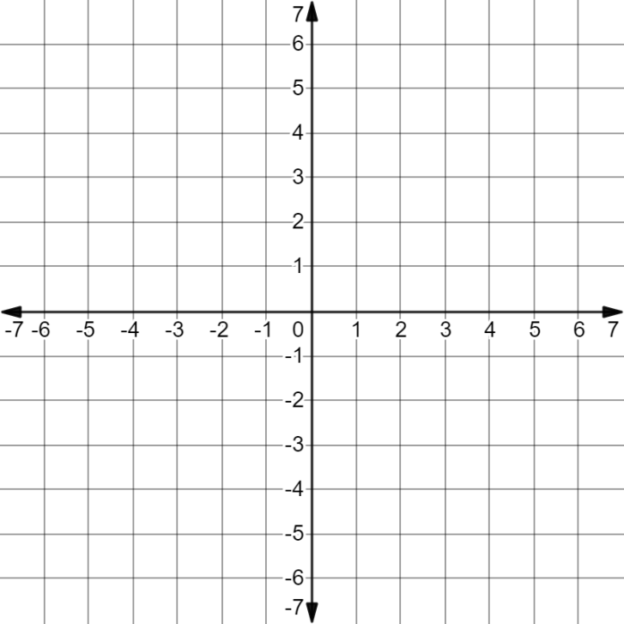

Use the coordinate grid to find the exact distance between $\left(−2,−5\right)$ and $(6,1)$.
The exact distance between $\left(−2,−5\right)$ and $(6,1)$ is __ units.
volume 1, pg. 225

Slide 15

Guided Instruction
volume 1, pg. 225

Slide 16
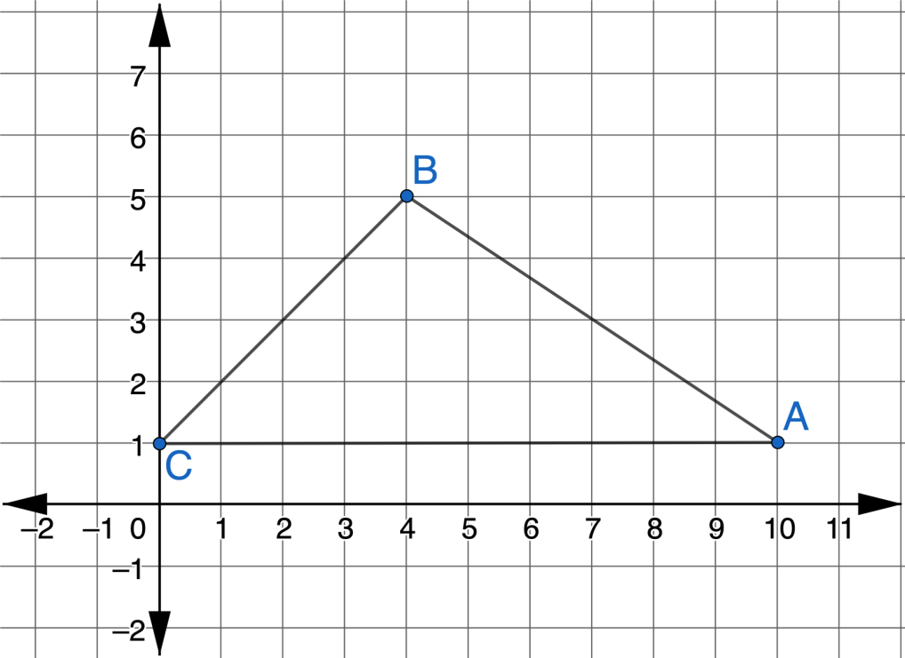
5.9.4 Guided Instruction: Converse of the Pythagorean Theorem
The sketch shows a design for a new roof.
volume 1, pg. 225

Slide 17
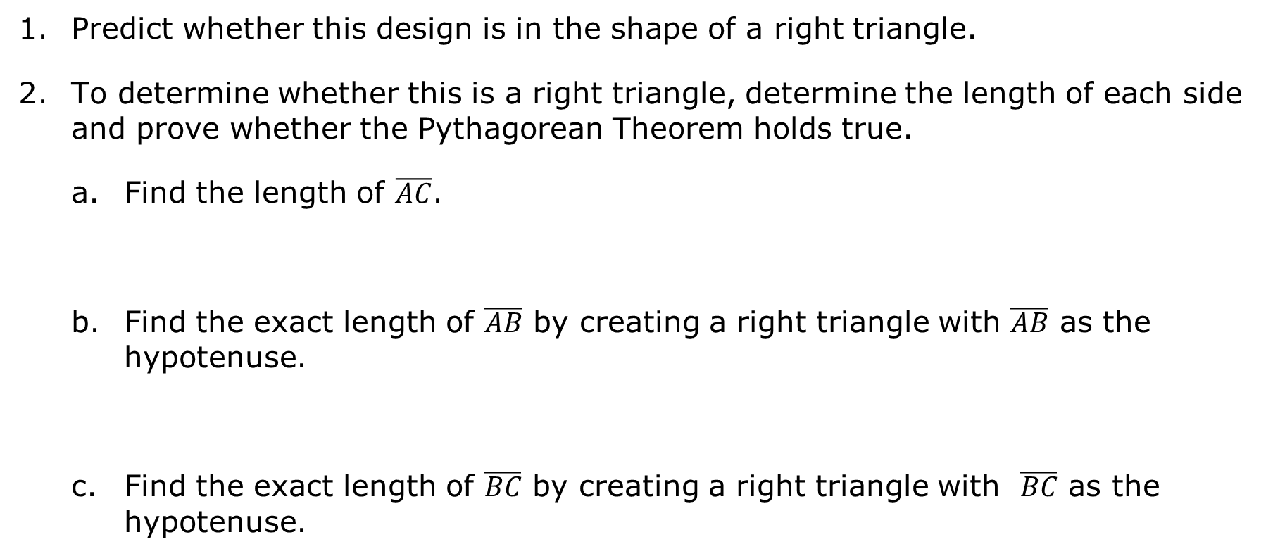
Predict whether this design is in the shape of a right triangle.
To determine whether this is a right triangle, determine the length of each side and prove whether the Pythagorean Theorem holds true.
Find the length of $\overline{AC}$.
Find the exact length of $\overline{AB}$ by creating a right triangle with $\overline{AB}$ as the hypotenuse.
Find the exact length of $\overline{BC}$ by creating a right triangle with $\overline{BC}$ as the hypotenuse.
volume 1, pg. 225

Slide 18
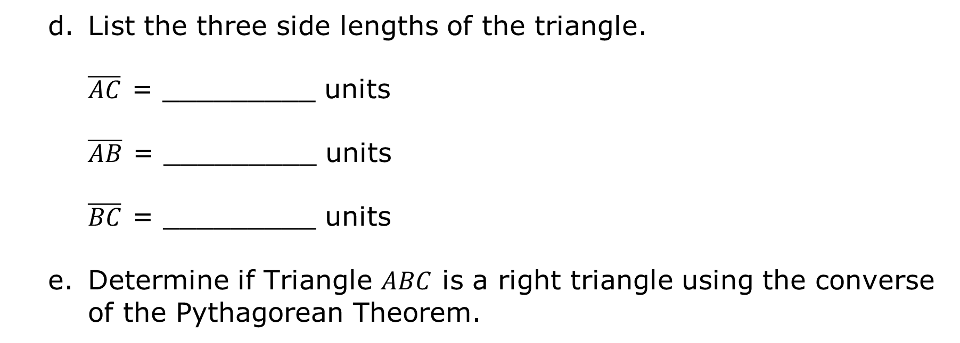
List the three side lengths of the triangle. $\overline{AC}$ = _________ units $\overline{AB}$ = _________ units $\overline{BC}$ = _________ units
Determine if Triangle $ABC$ is a right triangle using the converse of the Pythagorean Theorem.
volume 1, pg. 226

Slide 19
Complete the statement. The roof design satisfy the Pythagorean Theorem, therefore, the design a right triangle.
does
does not
is
is not
volume 1, pg. 226

Slide 20

Your Turn
volume 1, pg. 226

Slide 21
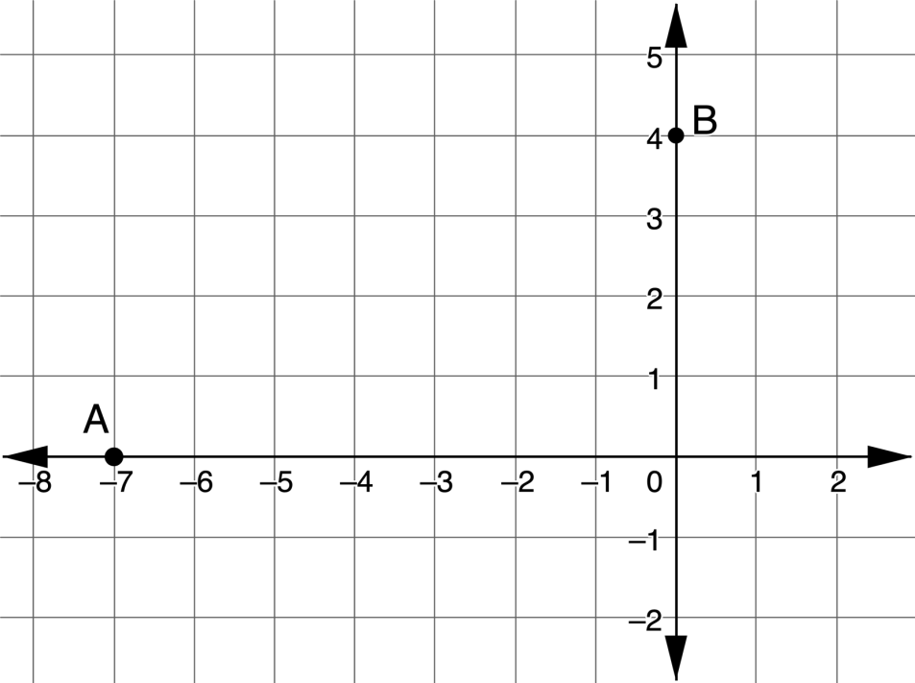
5.9.5 Your Turn!
Find the exact distance from Point $A$ to Point $B$.
volume 1, pg. 226

Slide 22
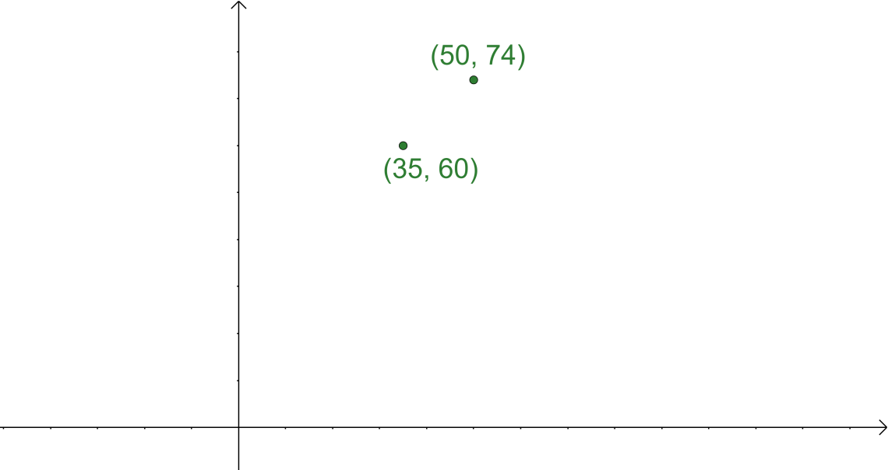
Find the exact distance between the two points.
volume 1, pg. 227

Slide 23
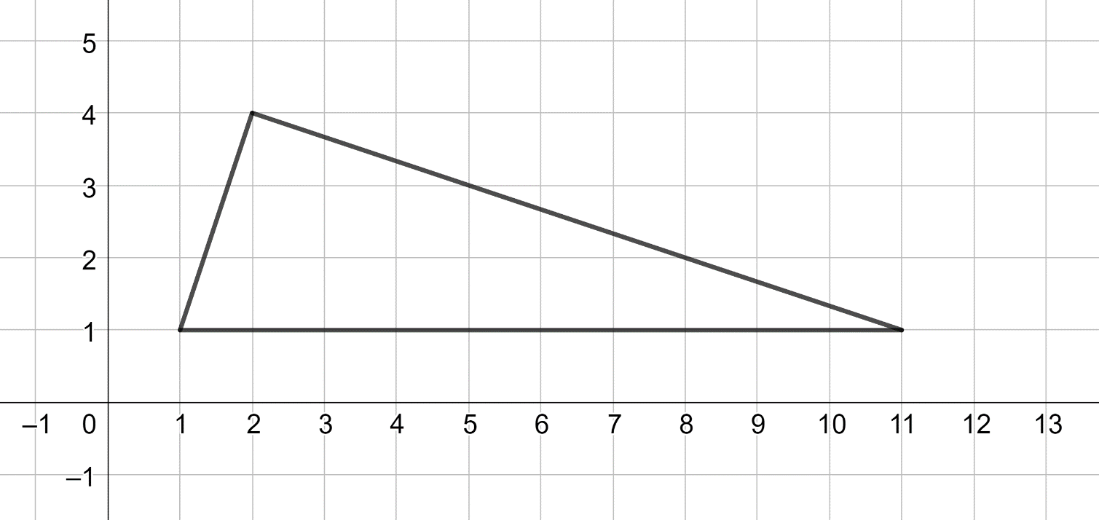
Use the converse of the Pythagorean Theorem to determine if the figure is a right triangle.
volume 1, pg. 227

Slide 24

Wrap-Up
volume 1, pg. 228

Slide 25
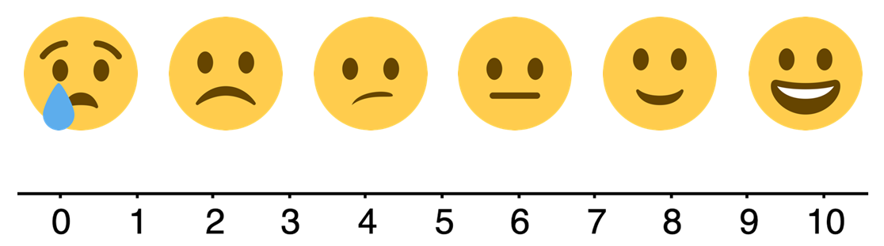
5.9.6 Wrap-Up: Reflection
Select the emoji face that corresponds to your feeling toward today’s learning target. I can determine the distance between two points on the coordinate plane.
volume 1, pg. 228

